Slide 1
An FPHS Approach to Improving Well-Being for All Missourians
(add facilitator’s name and agency)
HealthierMO.org

Slide 2
PURPOSE
Walk step-by-step through the FPHS workbook to operationalize Missouri’s FPHS model in order to assure health and well-being for everyone in our community
HealthierMO.org

Slide 3
OBJECTIVES
Learn about the FPHS model
Review local data
“Map” capabilities and areas
Develop an action plan
HealthierMO.org

Slide 4
GROUND RULES
You are responsible for our success!
Give each person a turn to speak.
Listen actively to others.
Respect, value, and appreciate all comments.
Silence and put away your phone.
Return from breaks on time.
HealthierMO.org

Slide 5
GROUND RULES
Think process, not personality.
Think about how it CAN be done, not how it can’t be done.
Think with flexibility – outside of the box.
Be willing to let go of the past to adapt and move forward.
Seek aspirational outcomes, not just completing tasks.
HealthierMO.org

Slide 6
GROUND RULES
Engage patterns, not specific problems.
Unlock change, don’t impose it.
The Facilitator may call a Time Out to keep the workshop on track and on time.
The Parking Lot may be used to note important comments to be followed up on at a later time.
HealthierMO.org

Slide 7
WHAT’S YOUR SUPERPOWER?
Share your name, job title and agency.
Describe your personal superpower.
HealthierMO.org

Slide 8
MISSOURI’S FPHS MODEL
Missouri’s Foundational Public Health Services (FPHS) model offers a consistent framework upon which we can align public health practice across the state.
HealthierMO.org

Slide 9
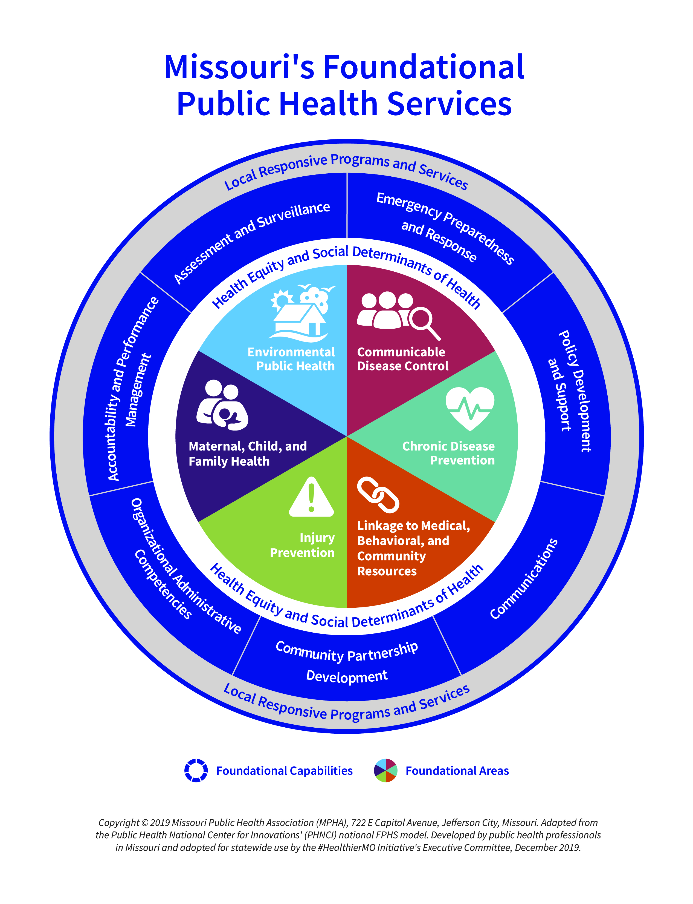

Slide 10
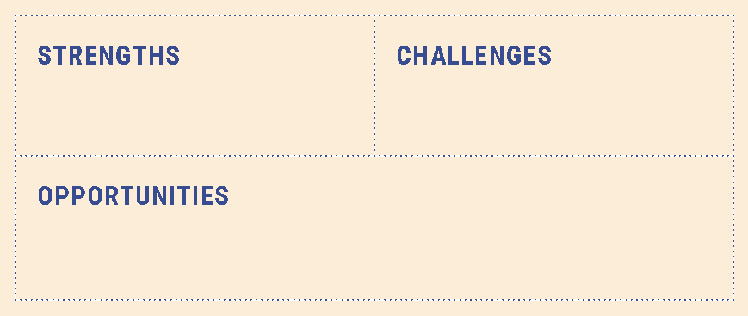
REFLECTION
What do you see as strengths, challenges, and opportunities related to the work we are about to start?

Slide 11
DATA
(add local data points and sources)
HealthierMO.org

Slide 13
MAPPING PROCESS
1
Step 1: Select one area of expertise and align it with one capability. Complete them in any combination and order.
Step 2: Review current data from your agency’s Capacity Assessment and other sources. Work through the discussion prompts in the workbook.
2
HealthierMO.org

Slide 14
MAPPING PROCESS
3
Step 3: Develop an action plan to build capacity for each selected capability. Prioritize focus areas from the action planning table in which to build capacity that will result in stronger, more equitable programs and services for everyone in your community.
Step 4: Repeat the process with another capability and area of expertise.
4
HealthierMO.org

Slide 15
KEY TERMS
Decision-maker: a person with the authority and power to make key decisions that affect entire systems and people
Health equity: understanding and providing what people need so they have a fair and just opportunity to achieve equal outcomes and live their healthiest life
HealthierMO.org

Slide 16
KEY TERMS
Missourians: all visitors, immigrants, students, travelers, transplants, and lifetime residents currently residing in Missouri, collectively referred to as “Missourians”
Stakeholder: any person with a vested interest or concern in something
HealthierMO.org

Slide 18
DISCUSSION
Add discussion questions from the FPHS workbook for the section you will be working on
Add question
HealthierMO.org

Slide 19
DISCUSSION SUMMARY
Summarize key points from discussion
HealthierMO.org

Slide 20
ACTION PLANNING
Potential Outcomes are drawn from the FPHS Capacity Assessment.
We can add Potential Outcomes and define Action Steps.
HealthierMO.org

Slide 21
PLANNING DISCUSSION
Which of these lines items should we focus on?
Which are most important and achievable?
Which are low-hanging fruit we can make a difference toward more quickly?
HealthierMO.org

Slide 22
PLANNING DISCUSSION
What actions should we take, and when?
Who will be responsible to take the lead on this action?
What resources will be needed to accomplish this action?
HealthierMO.org

Slide 23
REFLECTION
Based on everything we discussed today –
What strengths did you hear?
What challenges may exist?
What opportunities can you identify?
Note 1–3 action steps you will personally take as a result of today’s session.
HealthierMO.org

Slide 24
EVALUATION
(add how they can complete the session evaluation – handout or post-it notes – see Facilitator Guide for details)
HealthierMO.org

Slide 25
NEXT STEPS
(add any homework assignments and the date of the next session, if you already have it scheduled)
None of us can do this important work alone. Thank you for your engagement and commitment to building a healthier community for all of our residents.
HealthierMO.org

